Slide 1
Cloud GPU Rendering Scheduling Problem (CGRSP)
A mathematical formulation and empirical evaluation on heterogeneous GPU fleets
Michael Liem (M11215818) | Dept. of CSIE, NTUST
Advisor: Prof. Yuan-Shin Hwang | Co-advisor: Prof. Vincent F. Yu
Notes:
Thesis defense deck. Title: CGRSP, formulation and empirical evaluation.

Slide 2
Why scheduling rented GPUs is hard
Heterogeneous fleet
Availability
Mixed deadlines
RTX 3090, A5000, A4000 and A4500 differ in speed and hourly price, so the same job costs and takes differently per node.
Stock status drives provisioning delay, and execution time is stochastic (log-normal per complexity level).
Assumed mix of 20% rush (1 h) and 80% standard (8 h) renders, stress-tested on a saturated hectic day, sharing C_max = 5 workers.
Question: which dispatch policy keeps deadlines and waits low at minimal rental cost?

Slide 3
Contributions
1
Complete CGRSP formulation with stock-driven availability and bi-objective QoS-cost
2
Calibrated, constraint-checked discrete-event simulator (6,627 real jobs)
3
Ten-policy comparison: 30 paired seeds, Holm-corrected tests
4
Two schedulers: RH (anticipative) and CADR (cost-aware, low tardiness)
5
Regime map: EDF vs SPT crossover, C_max lever, monthly scale
6
Deployment rules grounded in paired tests

Slide 4
Formulation: QoS first, cost as tiebreaker
lex min ( C_QoS , C_Cost )
C_QoS = Σ [ α1·wait_j + α2·(1 − δ_j) ] C_Cost = Σ c_j
Constraints
Stochastic inputs
Each job executes exactly once over the service horizon. Dispatch follows submission; completion equals start plus execution. One job holds a node at a time.
Execution time ~ LogNormal(complexity, GPU). Provisioning delay depends on stock status and time of day.

Slide 5
Worked example: three jobs, two GPU types
Job | Complexity | Deadline | Placed on | Runtime
j1 | Low | 1 h (tight) | RTX 3090 | 59.7 s
j2 | Medium | 8 h | RTX A4000 | 68.7 s
j3 | Low | 8 h | RTX A4000 | 60.0 s
Outcome
All start at t = 0 with zero wait and meet every deadline, so cost decides placement. Total rental cost is about $0.017 and utilisation is 3 of 5 slots (60%).
QoS first, cost only among QoS-equivalent options.

Slide 6
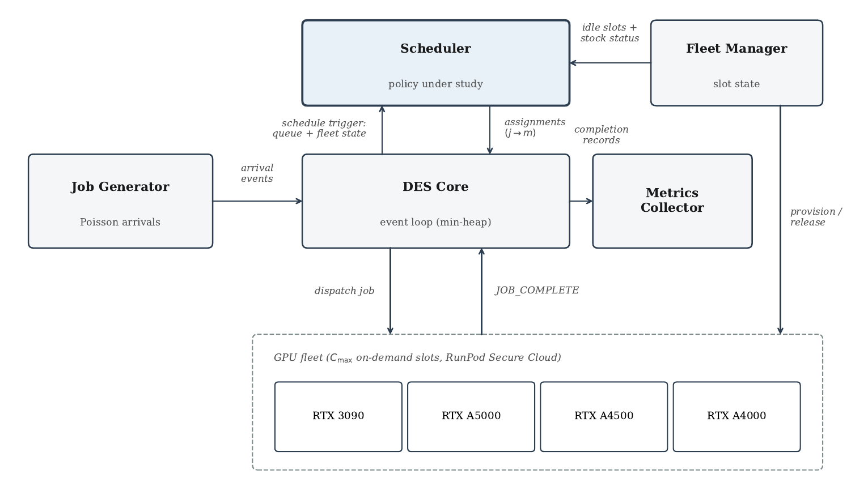
Simulator calibrated on real RunPod jobs
6,627
real rendering jobs (Jul 2025 to Jun 2026)
10
schedulers compared
30
seeds per scenario

Slide 7
Methods and validation
Statistics
Simulator checks
Every scheduler runs on the same 30 seeds (paired). Paired t-test with Wilcoxon backup, Holm-Bonferroni over a family of 24 comparisons, Cohen's d for effect size. Ties are reported with their p-values.
Log-normal service times fitted per complexity and GPU stratum (3 sparse strata use an estimated mean). A constraint verifier re-checks all ten policies on the seed-42 hectic run, and the baseline sweep row reproduces Phase 3 exactly.

Slide 8
Ten policies, two of them proposed
Rolling-Horizon (RH)
CADR
Plans over the slot-availability timeline and anticipated arrivals. Keeps SPT order for jobs with slack, promotes jobs that would otherwise miss, demotes doomed ones. Reserves idle capacity for rush orders below saturation.
Classifies jobs by a scale-free critical ratio and picks the cheapest deadline-feasible node. Matches RH on miss rate with far lower tardiness.
Baselines: FIFO, SPT, EDF, LCF, Balanced, Random, SPT+Rescue, Adaptive.

Slide 9
Ablation: what each ingredient buys
Reading it
Hectic day, 30 seeds. SPT cuts wait; rescue and deadline-risk ordering cut miss. RH beats SPT+Rescue on miss after Holm correction, but not on wait.

Slide 10
Hectic-day benchmark: deadline miss rate (%)
9.5%
RH lowest miss, tied with CADR
6.4 min
CADR tardiness vs 30.9 min for RH
140 min
RH wait, tied with SPT (141)

Slide 11
Where EDF and SPT trade places
Crossover
Surge-day load. EDF has significantly lower miss at 30% tight or less, the two tie at 50%, and SPT wins at 70% or more.

Slide 12
Concurrency cap is the main lever
Takeaway
Hectic day, 10 seeds (baseline differs from the 30-seed Phase 3 values). Miss falls under 3% at C_max 7 and to 0% for all three at 8, our current quota, where the policies tie. More slots, not a better ordering, remove the saturation misses.

Slide 13
Monthly: RH and CADR have the two lowest miss rates
30-day, 10 runs
One continuous 30-day calendar with backlog carried across days and drained at the end. Miss: CADR 7.14% vs RH 6.76%. Tardiness: 6.3 vs 19.3 min.

Slide 14
Snapshots contradict the assumed ranking
Policy | Assumed ranking | Snapshot-ordered ranking
CADR | 10.09% | 3.04%
SPT+Rescue | 12.50% | 3.24%
RH | 9.50% | 6.24%
SPT | 18.60% | 9.46%
FIFO | 24.85% | 17.90%
Concede
Snapshots list the 3090 94% of the time, the A4000 63%. That is listing share, not fulfilment; beta stays an assumption.
Consequence
RH ties CADR at baseline (p = 0.484). Under snapshot order CADR beats RH (p < 0.0001) and ties SPT+Rescue. Default to CADR.
Deadline miss rate, hectic day, 30 paired seeds
Level sweep, x0.75 to x1.00: deadline-aware beats deadline-blind and RH is lowest, tied with CADR at x1.00 and ahead only at x0.75. No policy copes at x0.50 or below; several reach zero miss at x1.25.

Slide 15
Deployment guidance
Default: CADR
Specialist: RH
Raise C_max
Ties RH on Phase 3 miss, has close monthly miss point estimates, and far lower tardiness.
Scarce-availability regime when only missed-deadline count or wait matters.
At saturation, lift the cap above RunPod's default of 5 (our quota is 8) to cut residual misses.
SPT remains a strong low-wait baseline. At our quota of 8 the policies tie on miss; the scheduler matters when the cap binds.

Slide 16
Limitations and future work
Limitations
Future work
Simulation only: no tight optimality bound (exact ILP intractable at about 950 jobs and not attempted even at toy size; the capacity bound certifies zero unavoidable misses, not the stochastic optimum). Hectic and surge loads are assumed stress loads (busiest recorded day: 415 jobs). Availability probabilities and delays are assumed; snapshots show scarce stock and rank GPU types in the reverse of the assumed order. Pods price snapshot, single-studio workload, non-preemptive jobs.
Validate on a live pipeline, add spot and reclaim dynamics, test learning-based dispatch, and extend to multi-provider fleets.

Slide 17
Thank you
Questions and discussion

Slide 18
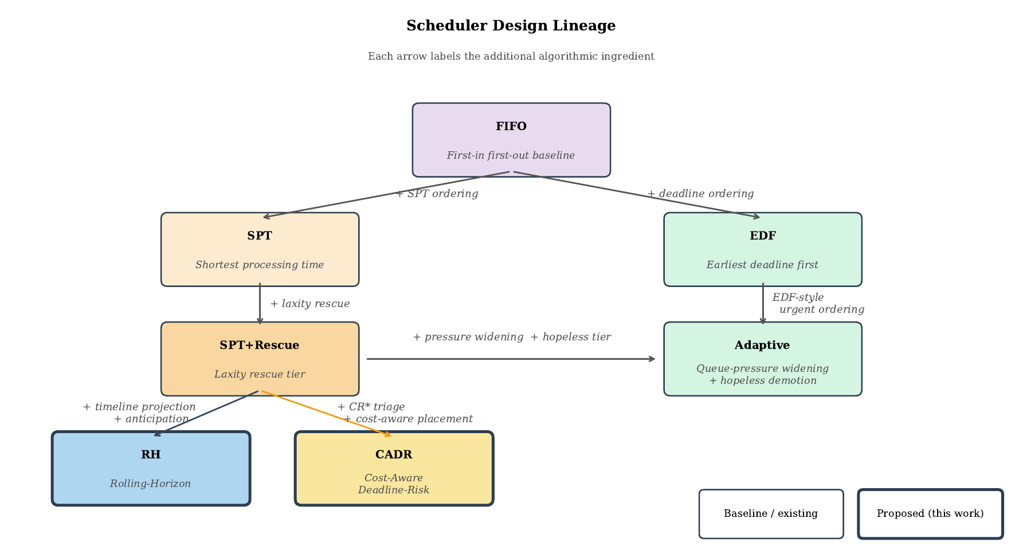
Backup: scheduler lineage

Slide 19
Backup: Phase 3 full results
Scheduler | Wait (min) | Miss % | Tardiness (min) | Cost ($)
RH | 140.24 | 9.50 | 30.86 | 6.48
CADR | 145.70 | 10.09 | 6.43 | 6.47
SPT+Rescue | 145.85 | 12.50 | 6.64 | 6.49
Adaptive | 169.64 | 12.49 | 4.45 | 6.48
SPT | 141.03 | 18.60 | 11.99 | 6.45
EDF | 174.16 | 15.81 | 5.74 | 6.48
LCF | 173.36 | 26.14 | 28.50 | 6.53
Balanced | 173.24 | 26.39 | 28.30 | 6.52
FIFO | 169.32 | 24.85 | 26.69 | 6.50
Random | 172.80 | 24.04 | 35.18 | 6.50
Hectic day, 30 seeds.

Slide 20
Backup: deadline sweep, miss %
Tight share | FIFO | SPT | EDF | LCF | Balanced | Random | SPT+Rescue
10% | 5.26 | 2.98 | 0.65 | 5.30 | 5.21 | 4.68 | 1.16
30% | 16.53 | 10.13 | 3.76 | 16.66 | 16.44 | 14.23 | 8.06
50% | 27.23 | 18.00 | 17.45 | 27.43 | 27.06 | 23.70 | 21.81
70% | 38.12 | 26.41 | 34.76 | 38.33 | 37.80 | 32.75 | 35.78
90% | 48.91 | 35.79 | 47.74 | 49.26 | 48.50 | 42.07 | 48.25
Surge day, 30 seeds per point.

Slide 21
Backup: C_max sweep, wait / miss
C_max | FIFO | SPT | EDF | SPT+Rescue | RH | CADR
3 | 392.6 / 57.6 | 358.7 / 51.5 | 395.4 / 51.9 | 379.0 / 50.1 | 369.8 / 46.5 | 377.4 / 49.0
5 | 164.5 / 22.9 | 141.7 / 18.9 | 176.7 / 16.4 | 145.0 / 12.4 | 135.4 / 8.4 | 142.3 / 9.1
7 | 46.0 / 6.6 | 39.0 / 2.5 | 45.5 / 0.0 | 38.8 / 0.0 | 38.5 / 1.7 | 39.2 / 0.0
8 (current) | 29.0 / 0.5 | 24.7 / 0.0 | 29.2 / 0.0 | 24.7 / 0.0 | 34.9 / 0.0 | 24.9 / 0.0
10 | 9.4 / 0.0 | 8.3 / 0.0 | 9.2 / 0.0 | 8.3 / 0.0 | 13.7 / 0.0 | 8.2 / 0.0
Wait in minutes / miss %, hectic day, 10 seeds.

Slide 22
Backup: Phase 4 monthly results
Scheduler | Wait (min) | Miss % | Tardiness (min) | Cost ($/mo)
RH | 102.85 | 6.76 | 19.30 | 48.56
CADR | 103.10 | 7.14 | 6.26 | 48.88
SPT+Rescue | 101.67 | 8.50 | 4.74 | 48.98
Adaptive | 117.83 | 7.95 | 3.64 | 49.15
SPT | 101.13 | 12.61 | 10.16 | 48.75
EDF | 118.62 | 9.15 | 3.97 | 50.43
LCF | 118.22 | 17.35 | 18.75 | 48.97
Balanced | 119.85 | 17.30 | 19.39 | 49.59
FIFO | 118.50 | 17.14 | 18.62 | 54.36
Random | 119.84 | 16.37 | 24.33 | 52.40
30 days, 10 runs. Miss values are point estimates; no paired comparison of policies at monthly scale.

